Slide 1
Rumor Detection on Twitter Using Multiloss Hierarchical BiLSTM with an Attenuation Factor

Slide 2
CSE 431
Group - 04
Task -02
Member 1:
Name: Mahin Shahriar Efaz Id: 20101225
Member 2:
Name: Aditi Saha Ria Id: 20101238
Member 3:
Name: Md. Raihanul Islam Bhuiyan Id: 20101239

Slide 3
Why Rumour Detection is Necessary?
01. Social media’s significance on people’s daily lives
02. Over 500 million new tweets are sent every day
03. Endangers a country's economy and undermines its stability
04. False information propagates faster and lasts longer

Slide 4
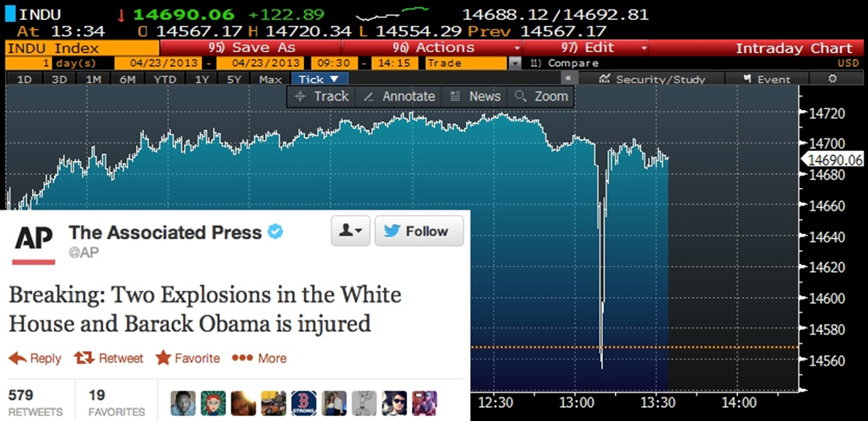
In 2013, the Associated Press's official Twitter account was hacked and sent out a rumor that the president of the US was injured in an attack. This rumor caused wide panic and resulted in a brief crash of the stock market, in which investors lost $136 billion in just two minutes (Ajao et al., 2018). This incident highlighted that misinformation can threaten people’s lives.

Slide 5
Solve rumour detection
By analyzing the post and it’s comments
By extracting deep information from the limited texts
Related works
Traditional Machine Learning and Deep Learning, AI.
RNN model
Graph-kernel-based hybrid SVM classifier, Heterogeneous network

Slide 6
Multiloss Hierarchical BiLSTM Model with an Attenuation Factor (MHA)
Development of MHA was inspired by multitask learning and the hierarchical structure.
About the Model:
This model is based on a bidirectional long short-term memory (BiLSTM) model
First time a multiloss function model with an attenuation factor for rumor detection to the post-level model to maintain its precision
Successfully combines post-level and event-level information for rumor detection
The results of an evaluation using actual data from Twitter show that this model achieved high accuracy with only a few posts.
Shorter model training time

Slide 7
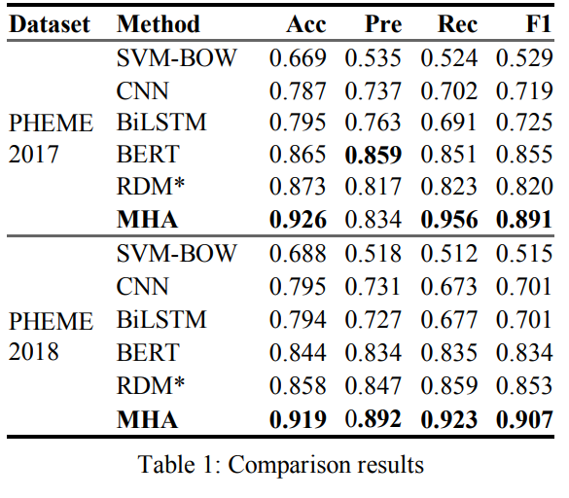
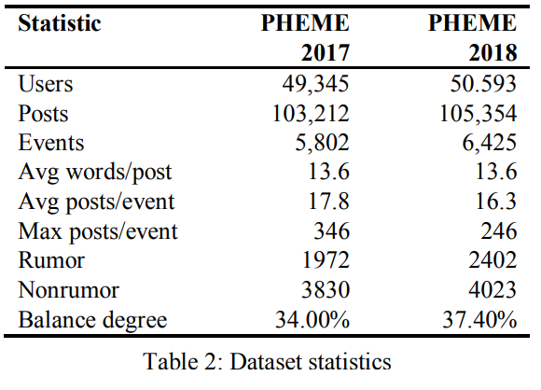
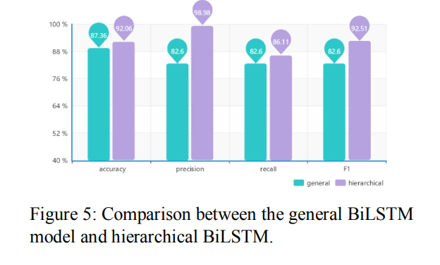
MHA model yields the best performance in real Twitter data from 2017 and 2018.
Hierarchical BiLSTM has higher accuracy, precision, recall, and F1.
Accuracy of the model with the event dataset is higher than the model with the post dataset.
Hierarchical structure has stronger detection capability than general structure.

Slide 8
Conclusion
THANK YOU!

